Slide 1


Computer Organization & Architecture
Chapter 12
CPU Structure and Function

Slide 2
12.1 Processor organization
Steps of CPU executing the instruction:
  Fetch instructions
  Interpret instructions/decoding instructions
  Fetch data
  Process data
  Write data
To do these things, CPU must contain ALU, CU
Also, CPU needs to store some data temporarily including the location of next instruction. Thus, CPU needs a small internal memory -- registers

Slide 3
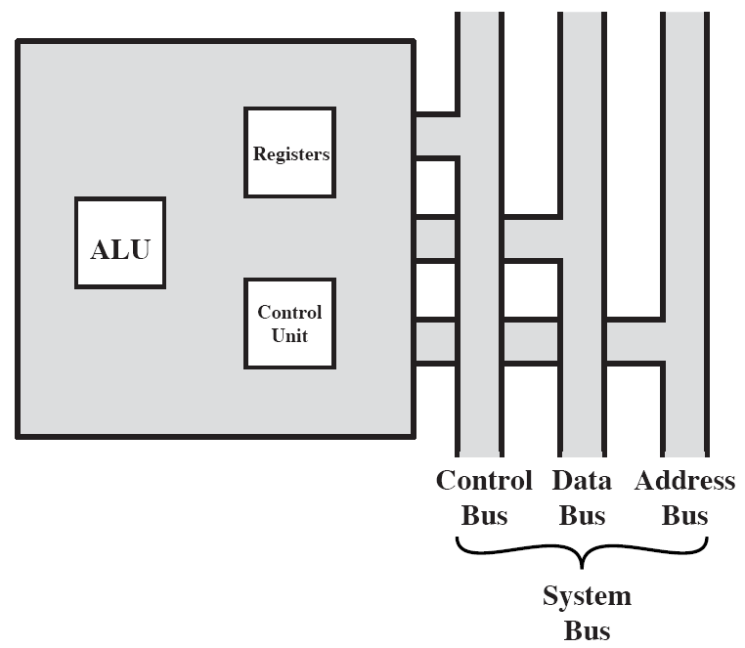
CPU With Systems Bus

Slide 4
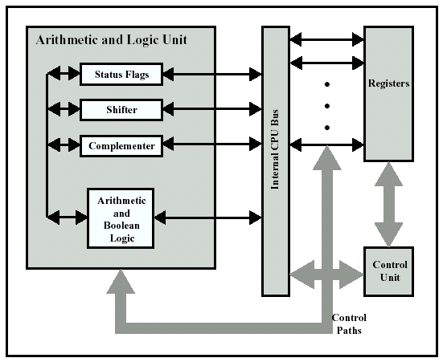
Internal Structure of The CPU

Slide 5
12.2 Register Organization
Def. : working space for temporary storage in CPU
Number and function vary between processor designs
One of the major design decisions
Located in top level of memory hierarchy
The registers in the CPU serve two functions:
  User-visible registers
    Programmer can use these registers to reduce accessing main memory
  Control and status registers
    Used by CU and privileged program (OS) to control the execution of user’ programs

Slide 6
User Visible Registers
We may characterize user visible registers as four categories:
  General Purpose
  Data
  Address
  Condition Codes

Slide 7
General Purpose Registers
  May be true general purpose
  May be restricted
    There may be dedicated registers for floating-point and stack operations
  May be used for data or addressing
Data
  Accumulator
Addressing
  Segment pointers, index register, stack pointers

Slide 8
Condition Code Registers
  Bits set by CPU hardware as the result of last operations
    COAPZS
      Positive, negative, zero, overflow, etc,
    After the result of last operations are stored, a condition code is also set and this code may be used for condition branch
  Can be read (implicitly) by programs
    e.g. Jump if zero
  Can not (usually) be set by programs
  Partially visible to programmers

Slide 9
Control & Status Registers
  There are a variety of registers that are employed to control operation of the CPU
  Most are invisible to programmers
  Four sorts of registers for instruction execution
    Program Counter (PC)
    Instruction Register (IR)
      The fetched instruction, for decoding
    Memory Address Register (MAR)
      address, connected to address bus
    Memory Buffer Register (MBR)
      Data, connected to data bus

Slide 10
Program Status Word—PSW
  A set of bits, Includes the following fields or flags:
  Condition Codes
    Sign of last result
    Zero: Set when the result is 0
    Carry
      set when operation resulted in a carry or borrow
    Equal: set when a logical compare result is equality
    Overflow: used to indicate arithmetic overflow
  Interrupt enable/disable
    allow or not allow a interrupt
  Supervisor
    indicates whether the CPU is executing in supervisor or user mode

Slide 11
Supervisor Mode
  Intel ring zero
  Kernel mode
  Allows privileged instructions to execute
  Used by operating system
  Not available to user programs

Slide 12
Other Registers
  May have registers pointing to:
    Process control blocks (see O/S)
    Interrupt Vectors (see O/S)
    Stack
    Page table
    Segment table
    Control of I/O operations
  Two factors considered in designing control register
    OS supporting
      CPU design and operating system design are closely linked, they should match each other
    Control information allocated in memory and registers
      Control information may be stored in the first few hundred words of main memory also, designer must decide how much is in registers and how much in memory—trade-off

Slide 13
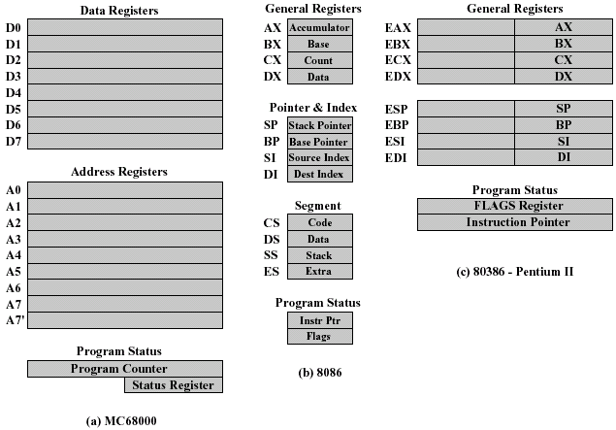
Example for Register Organizations

Slide 14
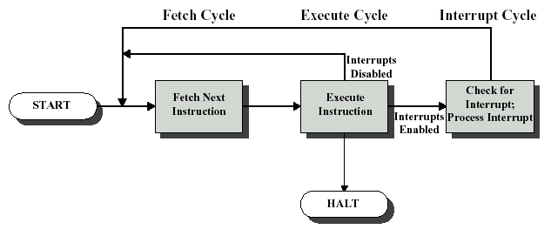
12.3 Instruction Cycle
Review

Slide 15
Indirect Addressing Cycle
  May require memory access to fetch operands
  Indirect addressing requires more memory accesses
  Can be thought of as additional instruction sub-cycle

Slide 16
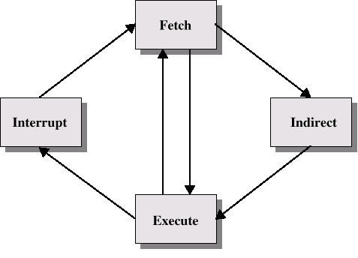
Instruction Cycle with Indirect

Slide 17

Instruction Cycle State Diagram

Slide 18
Data Flow (Instruction Fetch)
  Depends on CPU design, in general:
  Fetch
    PC contains address of next instruction
    Address moved to MAR
    Address placed on address bus
    Control unit requests memory read
    Result placed on data bus, copied to MBR, then to IR
    Meanwhile PC incremented by 1

Slide 19

    Data Flow -- Fetch Cycle Diagram

Slide 20
Data Flow (Indirect Fetch)
  IR is examined
  If indirect addressing, indirect cycle is performed
    Right most N bits of MBR transferred to MAR
    Control unit requests memory read
    Result (address of operand) moved to MBR
    MBR→IR

Slide 21

Data Flow -- Indirect Diagram

Slide 22
Data Flow (Execute)
  No fixed forms
  Depends on instruction being executed
  May include
    Memory read/write
    Input/Output
    Register transfers
    ALU operations

Slide 23
Data Flow (Interrupt)
  Simple and predictable
  Current PC saved to allow resumption after interrupt
    Contents of PC copied to MBR
  Special memory location (e.g. stack pointer) loaded to MAR
  MBR written to memory
  PC loaded with address of interrupt handling routine
  Next instruction (first instruction of interrupt handler) can be fetched

Slide 24

Data Flow -- Interrupt Diagram

Slide 25
12.4 Instruction pipelining
Pre-fetch
  Fetch accesses main memory
  Execution usually does not access main memory
  Can fetch next instruction during decoding and execution of current instruction
  Called instruction pre-fetch

Slide 26
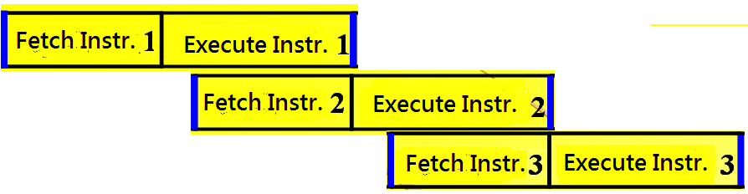
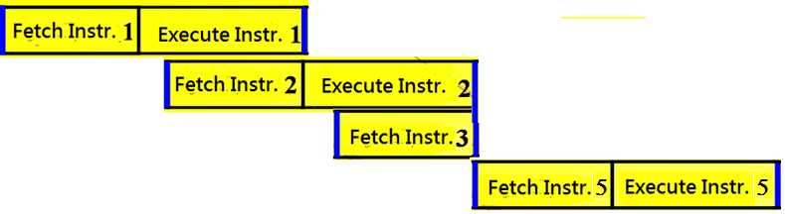
Conditional branch

Slide 27
Performance may be Improved by Pre-fetch
  Pre-fetch can improve speed of program execution
  But not doubled:
    Any jump or branch means that pre-fetched instructions are not the required instructions
  Add more stages to improve performance

Slide 28
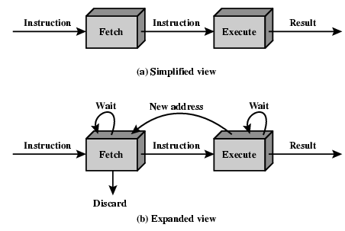
Two Stage Instruction Pipeline

Slide 29
Introduction to Instruction Pipelining
  In addition to faster circuitry, organization enhancement to CPU can improve computer performance
    Registers, cache, etc
  Another organizational approach is pipelining
  Instruction pipelining is similar to the assembly line in the factory

Slide 30
Laundry example:
Ann, Brian, Cathy, Dave
each have one load of
clothes to wash, dry,
and fold
Washer takes 30 minutes
Dryer takes 40 minutes
“Folder” takes 20 minutes
A
B
C
D

Slide 31
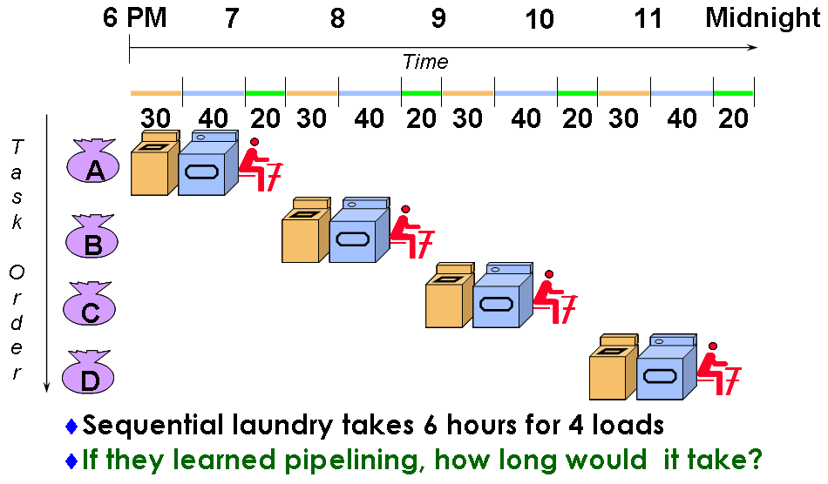
Sequential Laundry

Slide 32
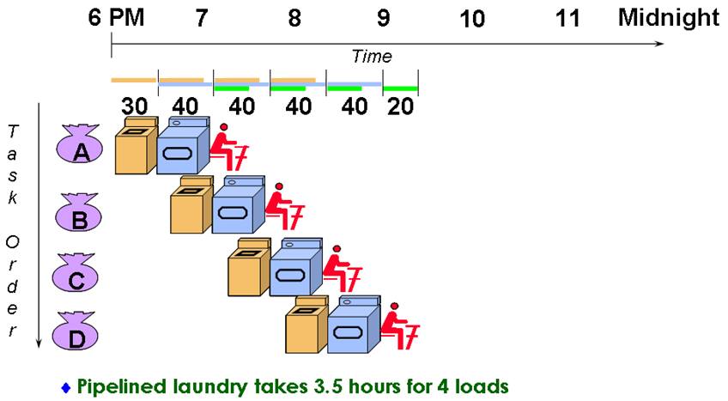
Pipelined Laundry

Slide 33
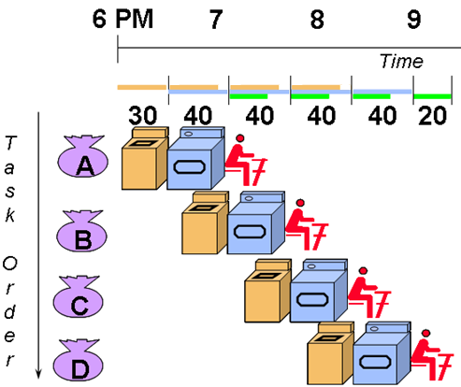
Doesn’t help latency of single task, but throughput of entire
Pipeline rate limited by slowest stage
Multiple tasks working at same time using different resources
Unbalanced stage length reduce the speed of pipeline
Stall for dependences

Slide 34
Pipelining
In fact, an instruction has a number of stages:
  Fetch instruction (FI)
  Decode instruction (DI)
  Calculate operands address (CO)
  Fetch operands (FO)
  Execute instructions (EI)
  Write operand (WO)
  The various stages will be nearly equal duration, we can overlap these operations

Slide 35
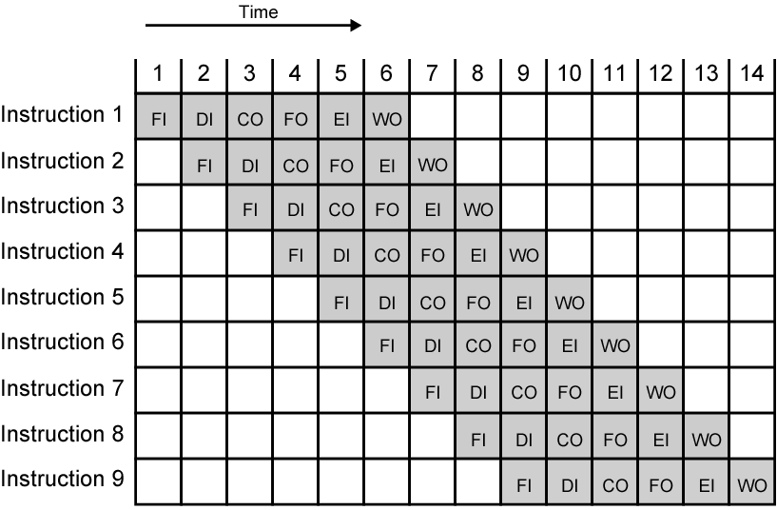
Timing Diagram for
Instruction Pipeline Operation

Slide 36
Specifications
  In Fig.12.10, each instruction goes through all six stages of the pipeline. This will not always be the case, so some null operations exist
    E.g LOAD instruction
  It is assumed that no conflicts and dependencies occur
  If the six stages are not of equal duration, short stages must wait
  Conditional branch and interrupt will reduce the performance of pipeline

Slide 37
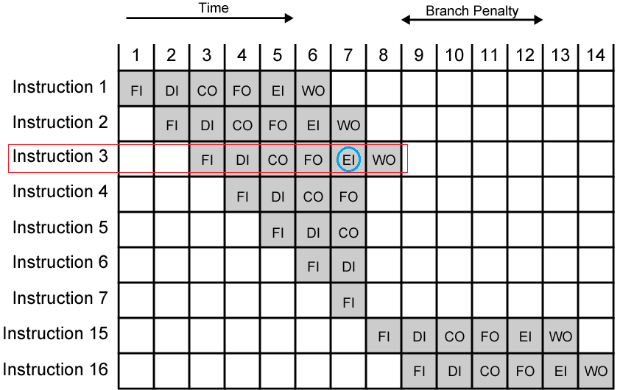
The Effect of a Conditional Branch
on Instruction Pipeline Operation

Slide 38
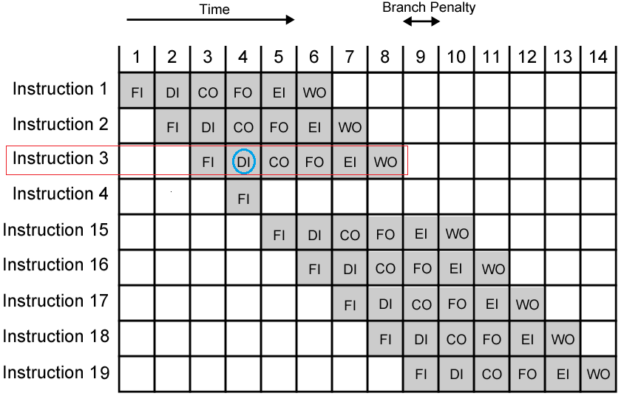
The Effect of a Unconditional Branch
on Instruction Pipeline Operation

Slide 39
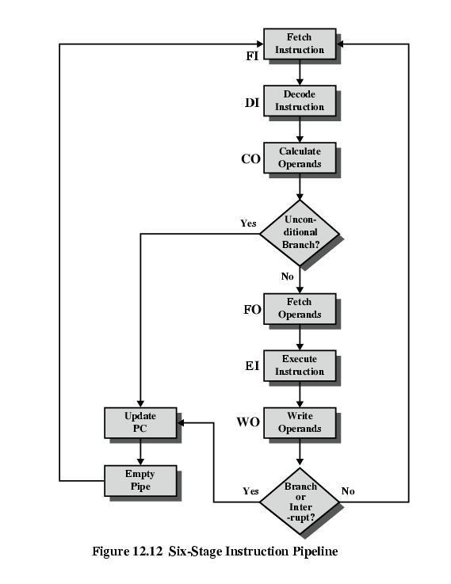
Six Stage Instruction Pipeline

Slide 40
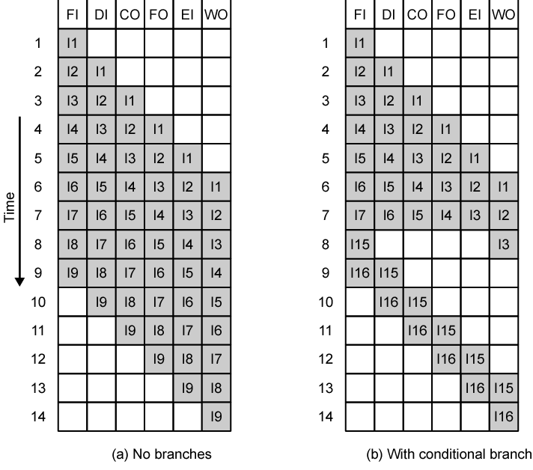
Alternative Pipeline Depiction

Slide 41
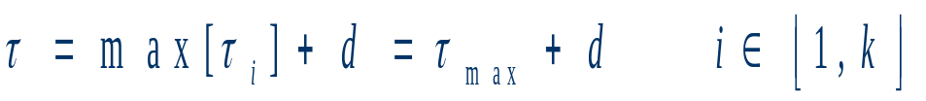
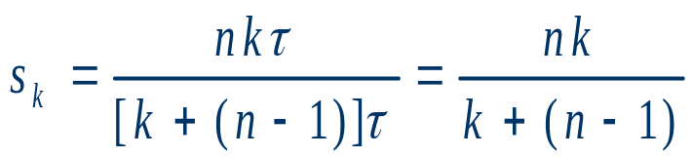
Pipeline Performance
  The cycle time of an instruction pipeline
    Instruction goes a stage in pipeline, the needed time:
    d : delay of a latch, d<<τ_{max}
  Suppose that n instructions are processed, with no , dependence, branches and interrupt. The total time to execute all n instructions:
    T _{k}=[k+(n-1)] τ
  Speedup Factor:

Slide 42
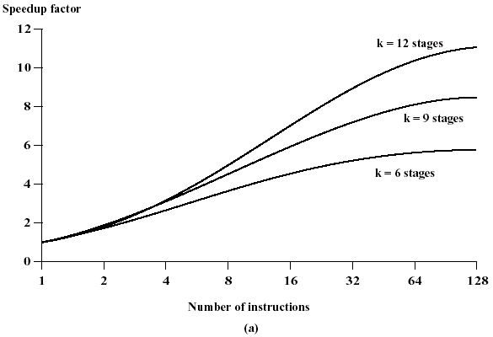
Speedup ~n Relationship

Slide 43
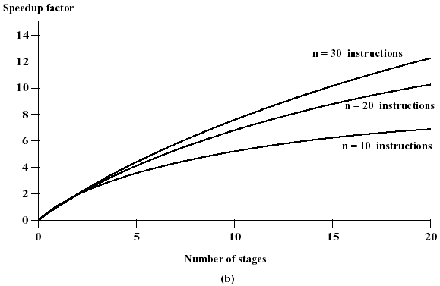
Speedup ~n Relationship

Slide 44
Question: the more stages in the pipeline, the faster the execution rate?
Answer: it is unlikely, because
  At each stage, there is some overhead involved in moving data from buffer to buffer and in performing various preparation and delivery function, lengthen the total execution time of a single instruction
  The more stages, the more complex control logic circuits

Slide 45
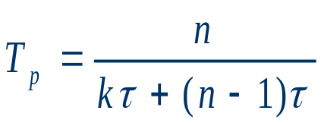
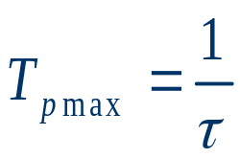

  Throughput (Tp): the number of instructions which the pipeline outputs in a unit time

Slide 46
An example
Consider that a single-pipeline processor with 50ns clock cycles has 5 pipeline stages: FI, DI, FO, EX and WB. Assume that each stage has equal duration, and requires 2 clock cycles. It need perform 8 successive instructions.
  Please draw the timing diagram of pipeline function stages and calculate the Speedup and throughput. Assume there are no conflicts, dependence or branch during the execution of instructions.
  If instruction 4 is a conditional branch instruction and the target of branch is instruction 7. In this execution, the result is to branch. Please draw the timing diagram of pipeline function stages and calculate the Speedup and throughput. Assume after instruction 8, there are no other instructions to execute.

Slide 47
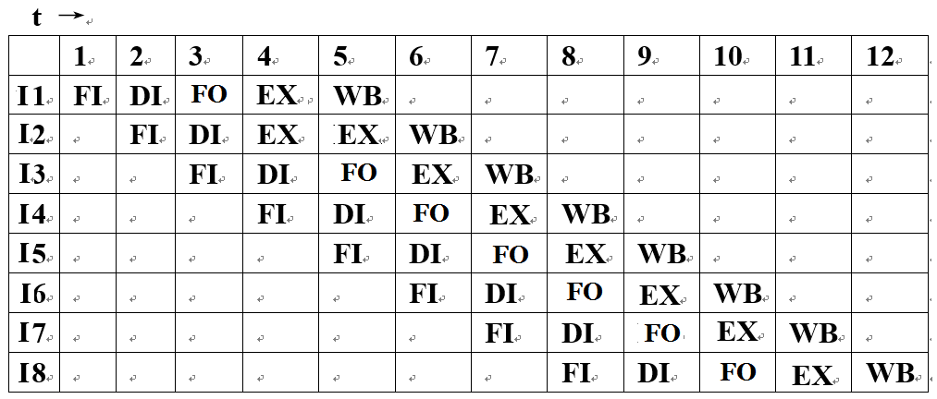
Solutions
  1) spatio-temporal diagram
Speedup= 8*5/[5+(8-1)]= 8*5/12=3.33
Throughput= 8/[5+(8-1)]tao
= 8/(12*2*50ns)=6.67*10³/s

Slide 48
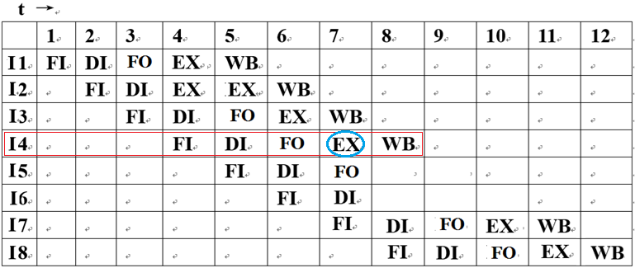
Solutions
  2) spatio-temporal diagram
Speedup=6*5/12=2.5
Throughput=6/(12*2*50ns)=5*10³/s

Slide 49
Pipelining Hazards
Def.
  All elements that block pipeline normally flowing or potentially result in incorrect computation
  A pipeline hazard occurs when the pipeline, or some portion of the pipeline, must stall because conditions do not permit continued execution
  Such a pipeline stall is also referred to as a pipeline bubble
Pipelining hazard is also called correlation or dependence
Pipelining hazard includes 3 types:
  Resource hazards
  Data hazards
  Control hazards (branching hazards)

Slide 50
Resource Hazards
Resource Hazards
  Two (or more) instructions in the pipeline need the same resource in the same time
  Structural hazards
  Reason: resources or functional units are not enough
Results leading to structural hazards
  Instructions must be executed in serial rather than parallel for a portion of pipeline
  Some functional unit is not fully pipelined, the pipeline can not proceed at the rate of one per clock cycle
Countermeasures
  Pipeline bubble
  parallelize or duplicate functional units

Slide 51
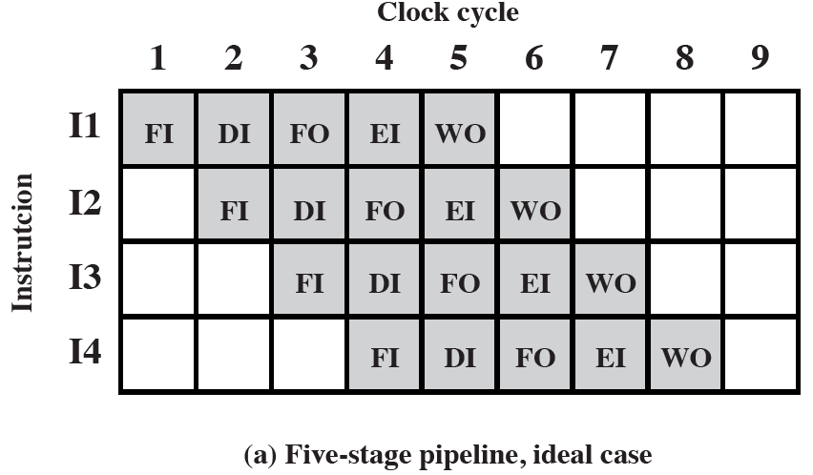
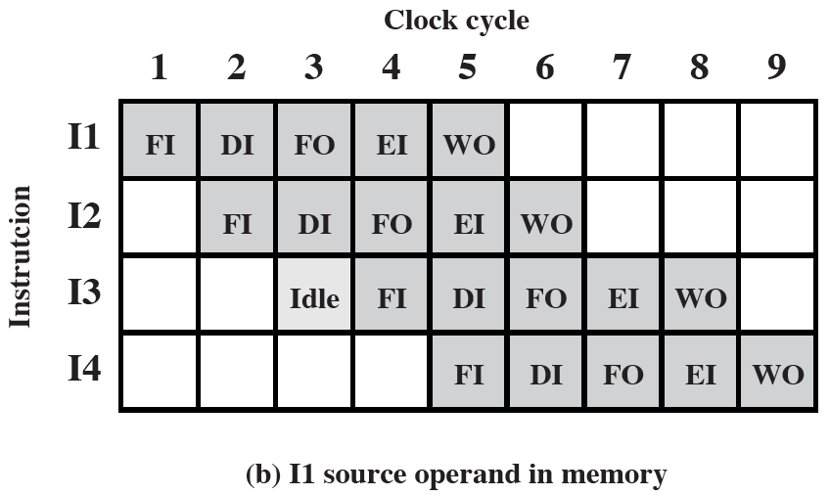

Slide 52
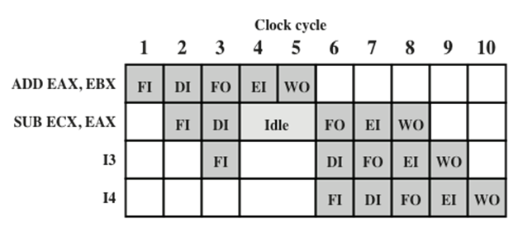
Data Hazards
A data hazard occurs when there is a conflict in the access of an operand location
Countermeasures
  Pipeline bubble
EAX =EAX+ EBX
ECX =ECX - EAX

Slide 53
Data Hazards
Read after write (RAW), or true dependency
  An instruction modifies a register or memory location
  Succeeding instruction reads data in memory or register location
  Hazard occurs if the read takes place before write operation is complete
Write after read (WAR), or antidependency
  An instruction reads a register or memory location
  Succeeding instruction writes to the location
  Hazard occurs if the write operation completes before the read operation takes place
Write after write (WAW), or output dependency
  Two instructions both write to the same location
  Hazard occurs if the write operations take place in the reverse order of the intended sequence

Slide 54
Control Hazards
Also known as a branch hazard
Occurs when the pipeline makes the wrong decision on a branch prediction
Brings instructions into the pipeline that must subsequently be discarded
Dealing with Branches
  Multiple Streams
  Pre-fetch Branch Target
  Loop buffer
  Branch prediction
  Delayed branching
  Completely removing branch penalty is very difficult
  Most of branch processing methods are for reducing the branch penalty

Slide 55
Dealing with Branches
Multiple Streams
  Have two pipelines
  Pre-fetch each branch into a separate pipeline
  Use appropriate pipeline
  Limits
    Leads to bus & register contention
    Multiple branches lead to further pipelines being needed
  Used by IBM370, 3033

Slide 56
Dealing with Branches
Pre-fetch Branch Target
  Target of branch is pre-fetched in addition to instructions following branch
  Keep target until branch is executed
  Used by IBM 360/91

Slide 57
Dealing with Branches
Loop Buffer
  A small ,very fast memory containing n most recently fetched in sequence instructions
  Maintained by fetch stage of pipeline
  If a branch is to be taken, the hardware first checks buffer before fetching from memory
  Very good for small loops
  c.f. cache, difference in smaller in size and only retains instructions in sequence
  Used by CRAY-1

Slide 58
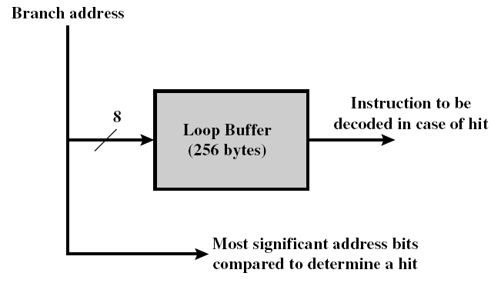
Dealing with Branches
Loop Buffer Diagram

Slide 59
Dealing with Branches
Branch Prediction
  Predict never taken
    Assume that jump will not happen
    Always fetch next instruction
    VAX 11/780
    VAX will not pre-fetch after branch if a page fault would result
  Predict always taken
    Assume that jump will happen
    Always fetch target instruction
    If a page fault occurs, wait until the branch instruction is completed

Slide 60
Dealing with Branches
  Predict by Opcode
    Some instructions are more likely to result in a jump than others
    Can get up to 75% success
  Taken/Not taken switch
    Based on previous history
      Bits (1~2bits)
      Good for loops and iterations

Slide 61
Dealing with Branches
  Branch History Table / Branch Target Buffer
    A small cache --- BTB/BHT
    Each entry consists of 3 parts: (see pp438 Fig.12.18)
      Branch instruction address
      Target address
      History state information

Slide 62
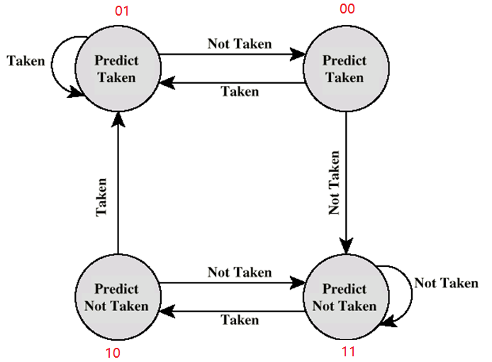
Dealing with Branches
Branch Prediction State Diagram

Slide 63
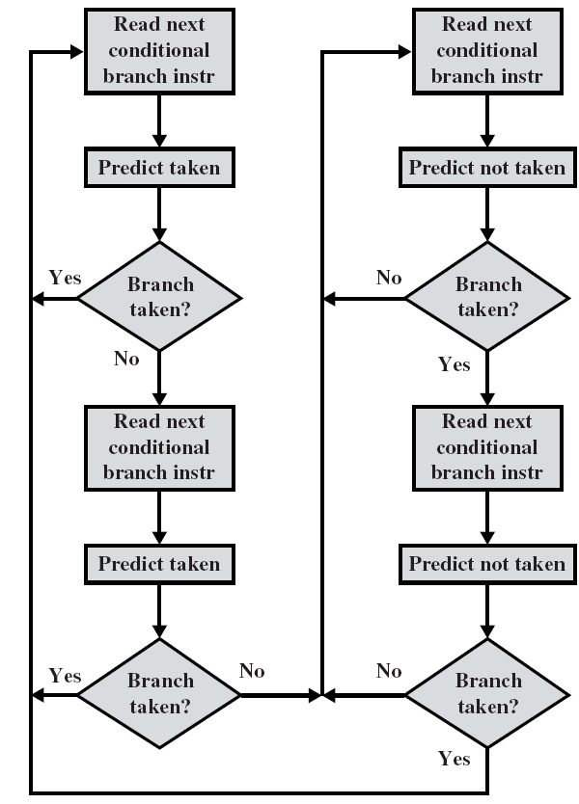
Branch Prediction Flow Chart

Slide 64
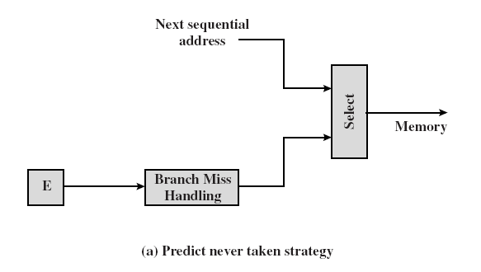
Dealing with Branches
Predict Never Taken Strategy

Slide 65
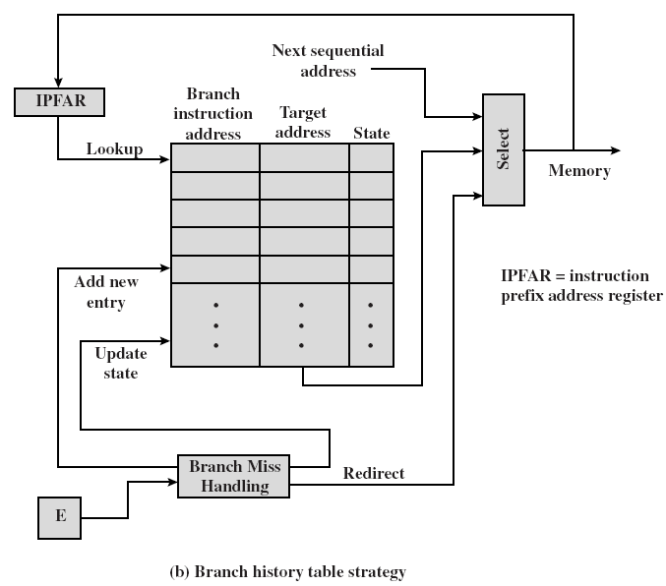
Branch History Table

Slide 66
Dealing with Branches
  Delayed Branch
    Insert NULL operations
      Stall the pipelining
      Used in early CPU
    Rearrange instructions
      Out-of-order execution
      Used now

Slide 67
Pipeline-oriented Optimized Programming
Basic principles:
  Reduce branch times
  Branch avoidance

Slide 68
An Example for Optimized Programming
for ( n=0;n<1000;n++)
{
multiplier=a*b+c;
element[n] *= multiplier;
}

Slide 69
Optimization Method
  recognize loop invariants
multiplier=a*b+c;
for ( n=0; n<1000; n++)
{
element[n] *= multiplier;
}

Slide 70
Another Example
for (n=0; n<1000; n++)
{
*a++=*b++ ^ *c++;
}

Slide 71
Optimization Method
  Unroll loops—pipelining
for (n=0; n<1000; n+=4)
{
*a++=*b++ ^ *c++;
*a++=*b++ ^ *c++;
*a++=*b++ ^ *c++;
*a++=*b++ ^ *c++;
}

Slide 72
Another Example
if (m>10)
{
m=10;
}

Slide 73
Optimization Method
  It may be replaced by a table lookup
m=translation_table[m];

Slide 74
Vocabulary
Branch prediction: 转移预测
Condition code: 条件代码
Delayed branch: 延迟转移
Flag: 标志
Instruction cycle: 指令周期
Instruction pipeline: 指令流水线
Instruction prefetch: 指令预取
Program status word: 程序状态字

Slide 75
Key Points
Internal structure of CPU
Register organization
Pipelining
How to process the branches

Slide 76
Homework
Both instructions and data are stored in the internal memory, then how can CPU distinguish them?
Suppose a pipeline with 5 stages: fetch instruction (FI), decode instruction (DI), execute (EX), memory assess (MA) and write back (WB). Assume that each stage has equal duration, and requires 100ns.
Please draw the spatio-temporal diagram for a sequence of 12 instructions, in which there are no conflicts and no data dependencies.
Under this situation, what is throughput of this pipeline and the speedup ratio of this pipeline?
3. 12.9

